Slide 1



Week 6
EXPLORATORY DATA ANALYSIS
https://intip.in/EDAIUP2022
Teaching Assistant :
Bramandika (06211940000059)
Maura Putri Defa (06211940000139)
Sepuluh Nopember Institute of Technology, Surabaya - Indonesia

Slide 2
Data Preprocessing
‹#›

Slide 3
Data preprocessing can refer to manipulation or dropping of data before it is used in order to ensure or enhance performance, and is an important step in the data mining process

Slide 4
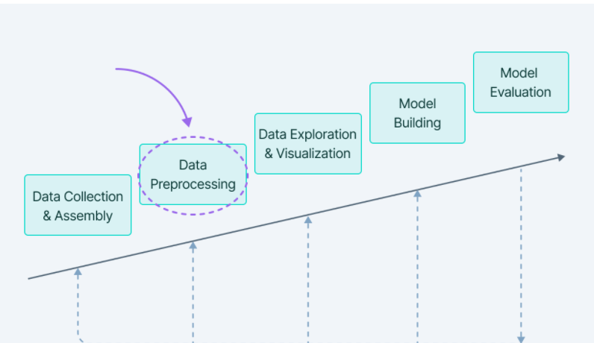
Data Preprocessing includes the steps we need to follow to transform or encode data so that it may be easily parsed by the machine.
The main agenda for a model to be accurate and precise in predictions is that the algorithm should be able to easily interpret the data's features.

Slide 5
Why is data preprocessing important?
Preprocessing of data is mainly to check the data quality. The quality can be checked by the following
Accuracy: To check whether the data entered is correct or not.
Completeness: To check whether the data is available or not recorded.
Consistency: To check whether the same data is kept in all the places that do or do not match.
Timeliness: The data should be updated correctly.
Believability: The data should be trustable.
Interpretability: The understandability of the data.
‹#›
Exploratory Data Analysis 2021

Slide 6
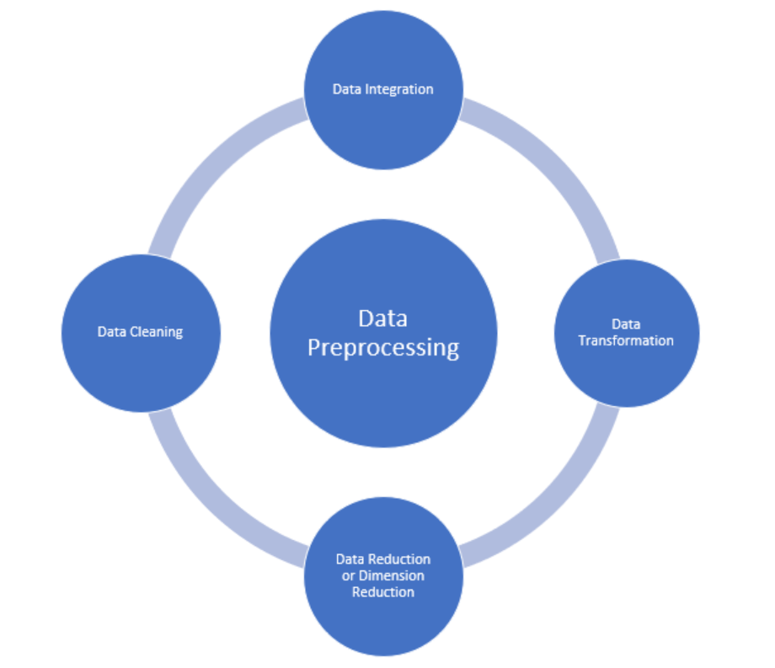
Major in Data Preprocessing
‹#›
Exploratory Data Analysis 2021

Slide 7
Data Cleaning
Data cleaning is the process to remove incorrect data, incomplete data and inaccurate data from the datasets, and it also replaces the missing values. There are some techniques in data cleaning
‹#›
Exploratory Data Analysis 2021

Slide 8
Handling Missing Values
Standard values like “Not Available” or “NA” can be used to replace the missing values.
Missing values can also be filled manually but it is not recommended when that dataset is big.
The attribute’s mean value can be used to replace the missing value when the data is normally distributed wherein in the case of non-normal distribution median value of the attribute can be used.
While using regression or decision tree algorithms the missing value can be replaced by the most probable value.
‹#›
Exploratory Data Analysis 2021

Slide 9
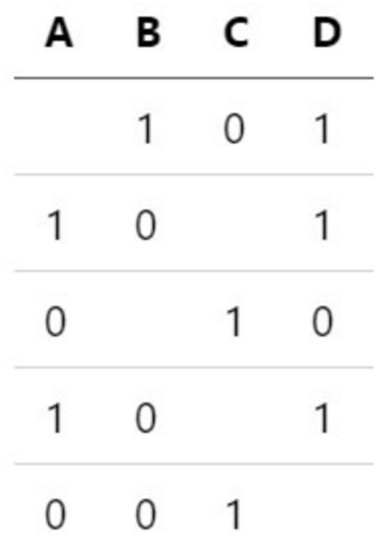
Missing Completely at Random (MCAR)
These are the missing data points that follow no discernable pattern. Often the choice for which value to impute is down to a flip of a coin. These values are most clearly identified when you cannot predict the missing value from the remaining know variables. The fact that it is missing is independent of the remaining variables.
‹#›
Exploratory Data Analysis 2021

Slide 10
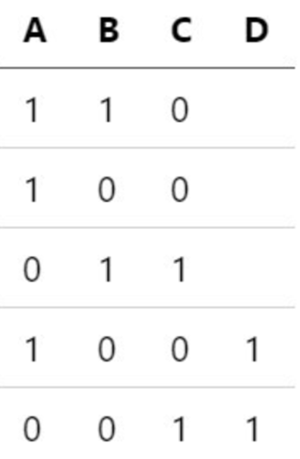
Missing at Random (MAR)
In contrast to MCAR, MAR does not assume that the other variables cannot predict the missing value. This type is perhaps more often the case when there are errors with recording the data correctly.
For example, imagine a sensor that misses a particular minute’s measurement but captures that data the minute before and the minute following. The missing value can roughly be interpolated from the remaining values to a reasonable degree of accuracy
‹#›
Exploratory Data Analysis 2021

Slide 11
Missing Not at Random (MAR)
Missing not at random or nonignorable data is data where the mechanism for why the data is missing is known. Still, the values can not effectively be inferred or predicted.
An example of this form of data is a demographic for a survey avoiding questions. For example, perhaps people in a certain age/income bracket refuse to answer how many vehicles or houses they own. The mechanism here may be apparent, but inferring the actual value of the missing data is difficult to predict accurately.
‹#›
Exploratory Data Analysis 2021

Slide 12
Structurally Missing Data
The missing data is missing for an apparent reason. Often the mechanism that caused the missing data is easily inferred. This type is data that is missing on purpose. For example, a survey that asks for income from employment would have missing values for those who do not have a job.
This type of missing data can also be produced purely as a result of data engineering.
For example, when handling time series data, transforming data into a tabular format is common. While this tabular format is ideal for out-of-the-box supervised models, the process of manipulating the data can produce missing values. When aggregating data over a time interval, certain intervals have no recorded data points if the data has inconsistent time stamps. This structure can cause missing values in the tabular aggregate.
‹#›
Exploratory Data Analysis 2021

Slide 13
Recap of Data Preprocessing
Standard values like “Not Available” or “NA” can be used to replace the missing values.
Missing values can also be filled manually but it is not recommended when that dataset is big.
The attribute’s mean value can be used to replace the missing value when the data is normally distributed wherein in the case of non-normal distribution median value of the attribute can be used.
While using regression or decision tree algorithms the missing value can be replaced by the most probable value.
‹#›
Exploratory Data Analysis 2021

